Slide 1
Release Pipeline Azure
Taulant Racaj

Slide 2
Agenda
Software and Tools
High Level Infrastructure Diagram
Infrastructure Resources
Kubernetes Scaling Strategy
Branching Strategy
Local Development
Release Flow
Best Practices for Building Software Artifacts
Quality Gates
Security
Infrastructure Security
Microsoft Defender for cloud
DEMO

Slide 3





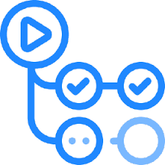

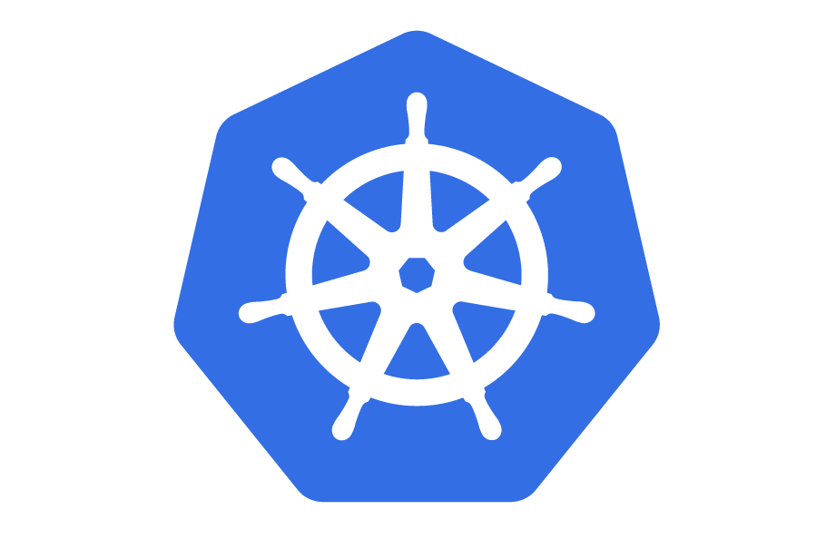






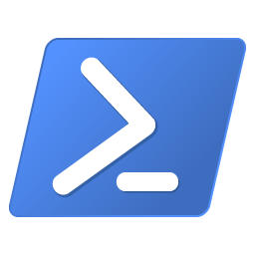
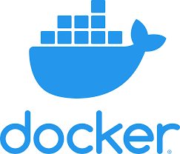
Software and Tools
GitHub
Bash
Azure (CLI)
Open Liberty
Chocolatey
VS Code
Kubernetes (CLI)
Docker
PowerShell

Slide 4
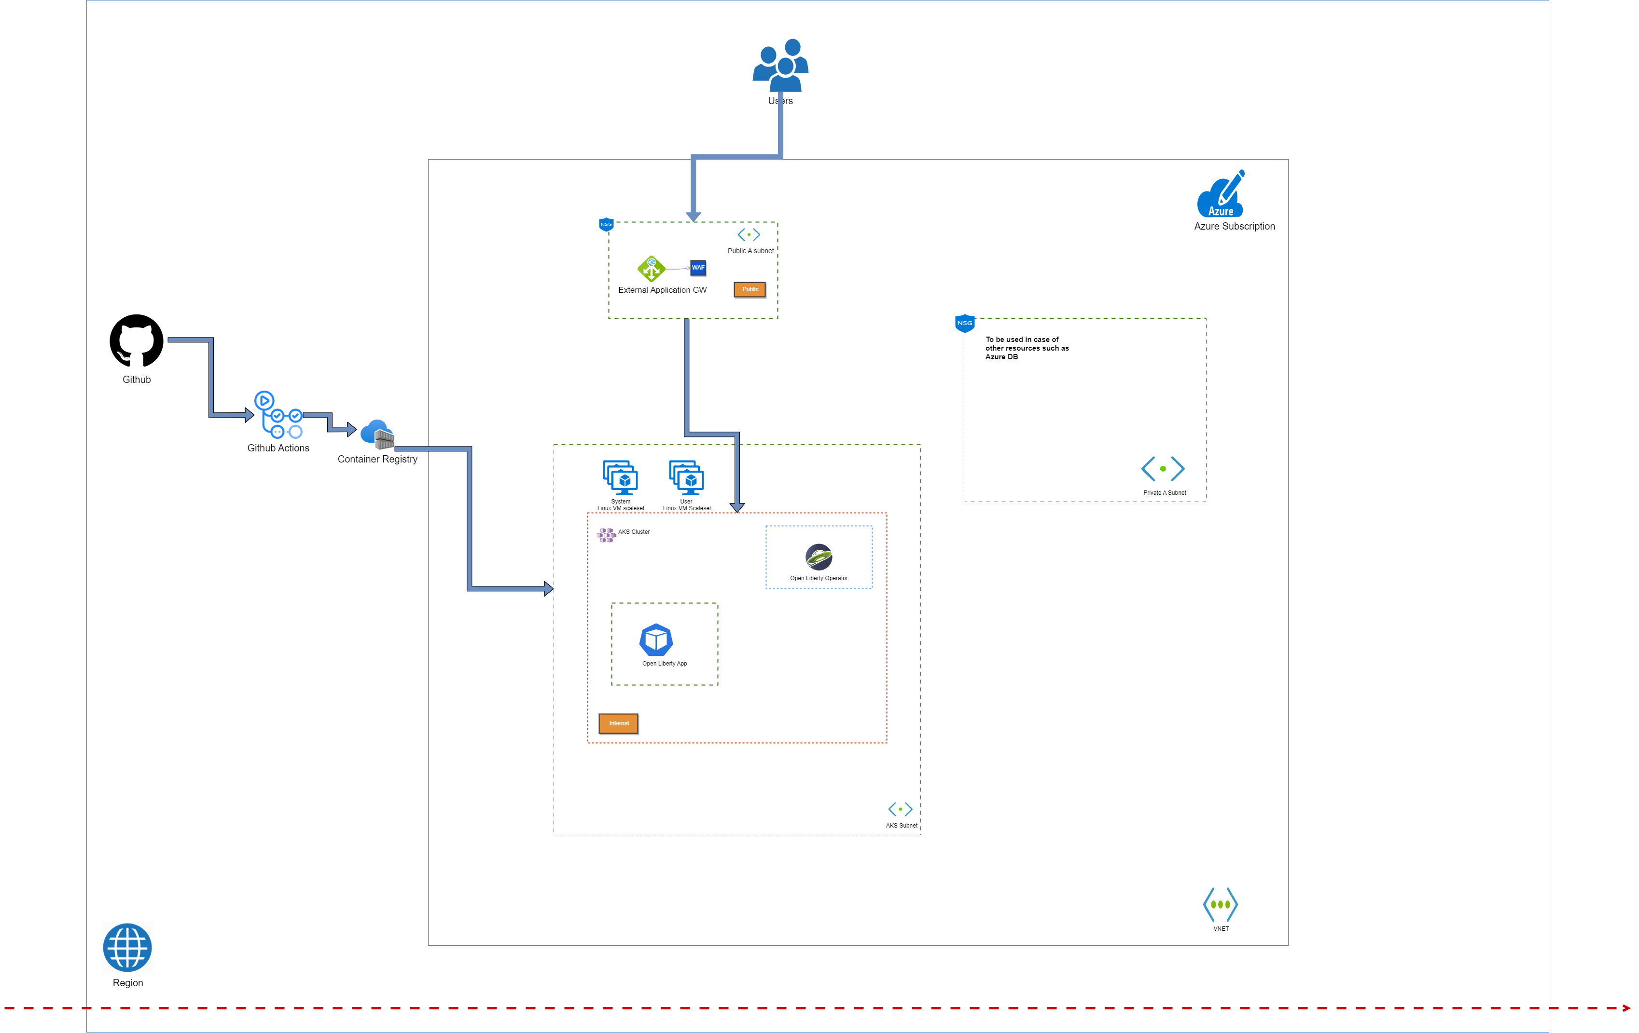
High Level Infrastructure Diagram
File can be found under -> 1.HighLevel_Infra_Diagram.png file on GitHub

Slide 5









Resources
AKS
Application GW
Vnet
Load Balancer
WAF Policy
Log Analytics
Azure CR
VM Scale set
Key Vault

Slide 6
Kubernetes Scaling Strategy
Node Autoscale
Horizontal Pod Autoscaler (HPA)
Cluster Autoscaler
Documentation under -> Kubernetes scaling strategy.docx file on GitHub

Slide 7
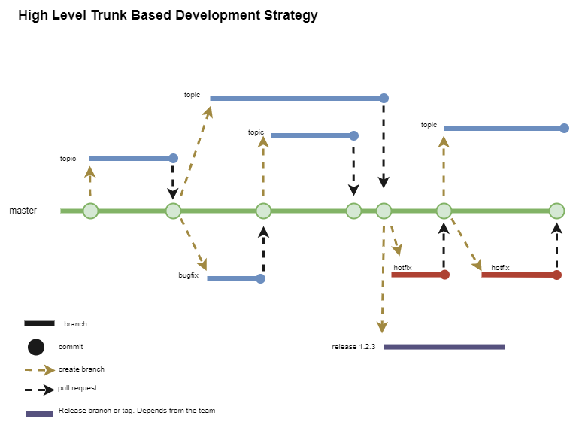
Branching Strategy
File can be found under -> Branching Strategy.docx file on GitHub

Slide 8
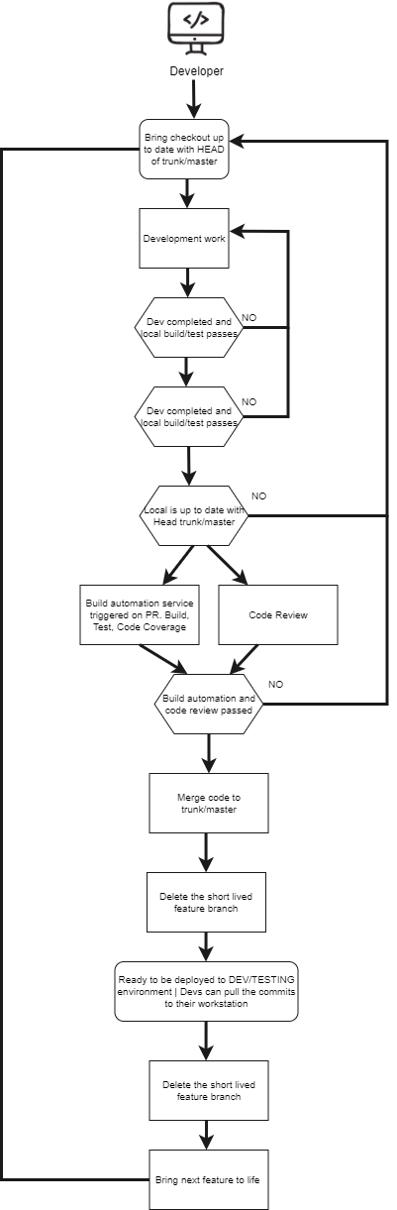
Local Development
File can be found under -> 3.LocalDevelopment.drawio.png file on GitHub

Slide 9
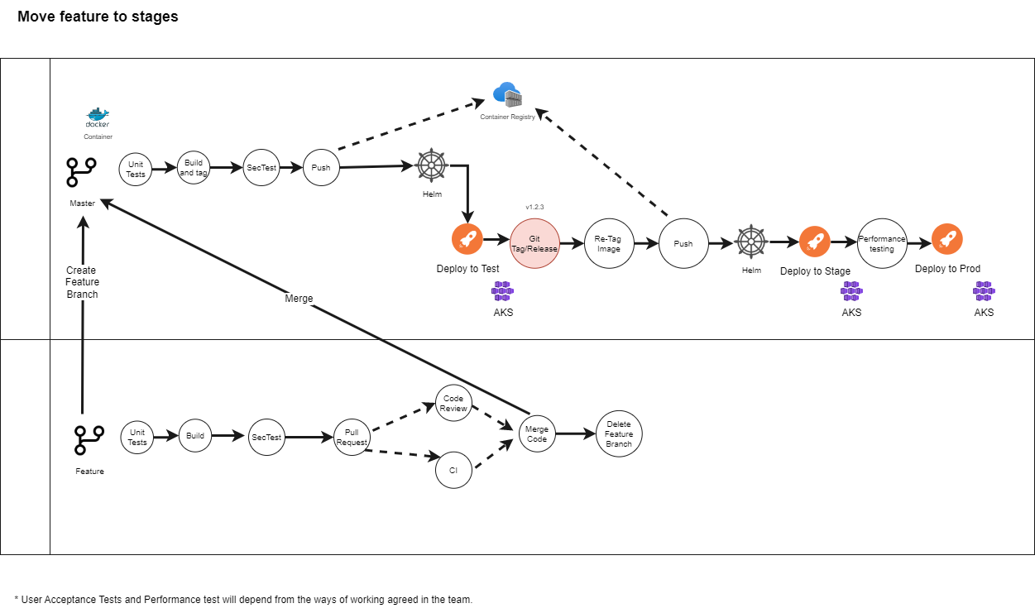
ReLEASE fLOW
File can be found under -> 4.CI_CD.drawio.png file on GitHub

Slide 10
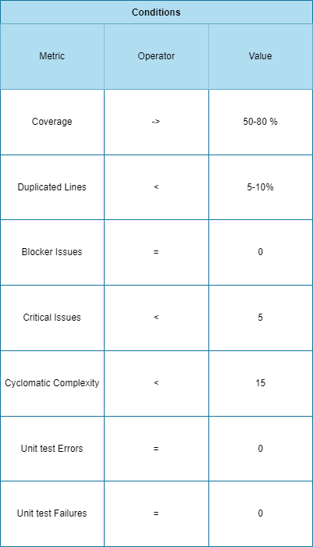
QUALITY gATES

Slide 11
Security
Docker Security - https://cheatsheetseries.owasp.org/cheatsheets/Docker_Security_Cheat_Sheet.html
Static application Security testing- Analyze the code without executing it https://owasp.org/www-project-top-ten/ Find Vulnerable (e.g. SQL injection) dependencies - Integrate in early stages
Dynamic application security - Integrate in later stages when application is running on an environment (XSS, SQL injection) - OWASP ZAP tool, HCL App Scan
Interactive application security testing - Combination of SAST and DAST
Runtime application self-protection (RASP) - This requires development , in JAVA Instrumentation Interface can be used https://docs.oracle.com/javase/7/docs/api/java/lang/instrument/Instrumentation.html. Tools such as Imperva can help to avoid development.
Dependency Scanners - Software Composition Analysis (SCA) Tools such as Dependency Track can help here. (SBOM) - Dependency Track

Slide 12
INFRASTRUCTURE SECURITY AKS
WAF
Network Security
Cluster Security (API Server)
Key Vault
Kubernetes Secrets
Pod Management Security (MI)
Node Security
Security patches
Node Storage
Azure Data Disk – encrypted
Kubernetes Network Policy
Azure Security Benchmark
Documentation under -> AKS Security.docx file on GitHub

Slide 13
Microsoft Defender for cloud
Microsoft Defender for Cloud is cloud-native solution for securing containers, and it protects almost all significant container resource types.
Microsoft Defender for Containers
Environment hardening
Vulnerability assessment
Run-time threat protection for nodes and clusters
https://learn.microsoft.com/en-us/azure/defender-for-cloud/defender-for-containers-introduction

Slide 14
DEMO
Terraform Scripts
Infra Pipeline
Open Liberty Demo build and deployment

